Slide 1
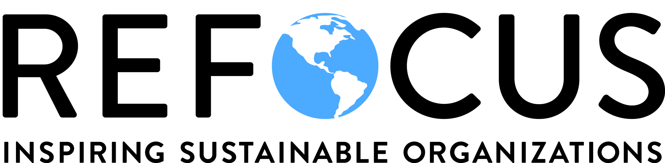
AASHE Webinar:
Leading Deeper Change in Higher Education Through the REFOCUS Applied Learning Program
- May 27th, 2019 -

Slide 2
WEBINAR AGENDA
Assessing What’s in Focus
Sustainability as a Management Innovation
Introduction to REFOCUS
The Stories of AASHE Members
Question & Answer Period

Slide 3
ASSESSING WHAT’S IN FOCUS: Are We Solving the Right Problem?
“The most common source of mistakes in management decisions is the emphasis on finding the right answer rather than the right question.”
Peter Drucker
Notes:
Peter Drucker, world-renown management consultant, educator and author was described as "the founder of modern management. He was quoted saying, “The most common source of mistakes in management decisions is the emphasis on finding the right answer rather than the right question.”
You may wonder what this has to do with organizational sustainability or transformational change
Naturally, sustainability leaders spend a heck of a lot of time and energy focused on measuring and taking action to improve how we perform across the triple-bottom-line …
As much as pursuing sustainability calls for focus on better triple-bottom-line performance, I would argue we may be not be aware of the problem that is most critical to our success

Slide 4
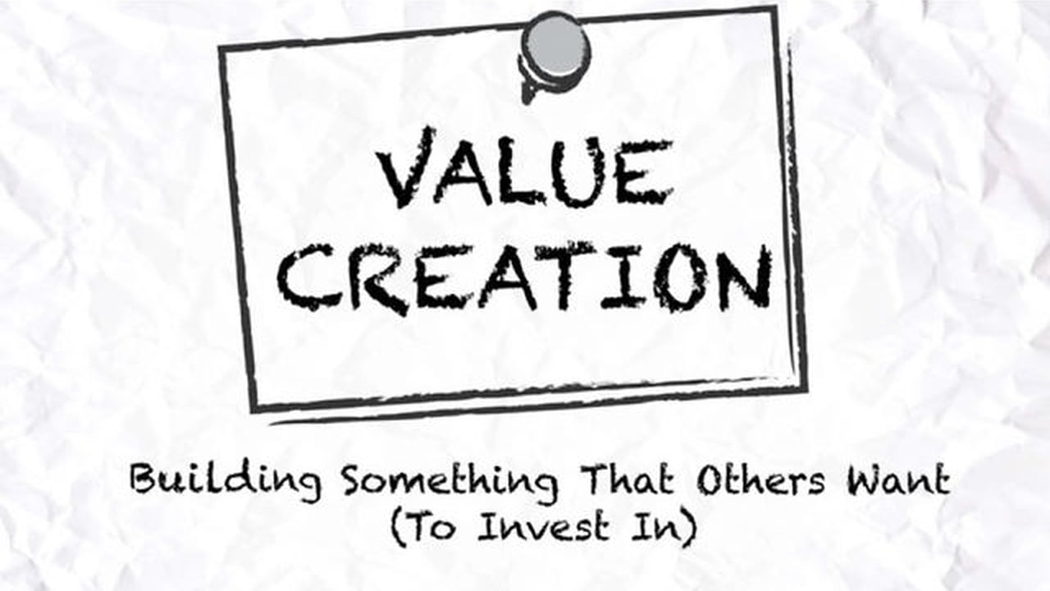
ASSESSING WHAT’S IN FOCUS: Why Does Your Program Exist?
Notes:
Beyond it being the right thing to do, the leaders that decided to invest in a sustainability program have likely done so to generate some specific value or benefit to the organization.
This could look like a combination of:
saving money through operational efficiencies
developing a positive image for being a responsible corporate citizen
contributing to a reputation as a leader and innovator.
It could also be that the program is limited by the scope of what it is expected to address. Examples would include:
focusing on reducing environmental impact, or
internal and direct sources of impact, separate of the organization’s interactions with the outside world.
The important thing to acknowledge is that the value a program was established to deliver isn’t likely critical to the organization’s performance or expected to lead toward transformational change.
So long as a program’s mandate is significantly restricted, sustainability champions will struggle to affect the more systemic and foundational change needed to demonstrate sustainability’s potential.

Slide 5

ASSESSING WHAT’S IN FOCUS: Sustainability Movement Plateau
Notes:
As much as organizations are allocating significant budget, dedicating teams of staff and undertaking significant projects to improve their performance, in most cases their internal sustainability function is not yet core to the organization’s success
Sustainability is still treated as a burden or in the best case, a source of limited opportunity; not a priority or a strategic imperative.
This is perhaps best evidenced
While a growing number of organizations are working hard to address their sustainability, make no mistake; progress has proven relatively slow and incremental in nature.
Few have fundamentally shifted how their organization functions and generated the kind of deeply rooted change that is absolutely necessary for realizing our climate change and broader sustainable development goals
As I’m sure many of you are well aware, the real challenge lies beyond the indicators

Slide 6
ASSESSING WHAT’S IN FOCUS: Self-Reflection Questions
What purpose or function is your program established to deliver?
How do you or your boss measure the success of your program?
Notes:
These are some of the important questions that Ryerson’s sustainability team answered as part of clarifying why their sustainability program exists
Say what you think works.

Slide 7
WEBINAR AGENDA
Assessing What’s in Focus
A Management Innovation
Introduction to REFOCUS
The Stories of AASHE Members
Question & Answer Period

Slide 8

A MANAGEMENT INNOVATION
The Lens of Sustainability
Notes:
THIS IS YOUR BREAD AND BUTTER – I WANTED TO GIVE YOU SOME FREEDOM AS TO WHAT TO FOCUS ON. AM HAPPY TO BUILD THE SLIDE BASED ON WHATEVER CONTENT YOU THINK IS BEST TO FOCUS ON.
Now that we’ve examined what holds sustainability back, let’s have a closer look at it’s often unrecognized potential
Conventional management practices typically omit many sources of significant opportunity and risk; this is exaggerated as the world becomes more complex and the rate of change accelerates.
We believe pursuing sustainability and in doing so, adopting and employing a more holistic, long-term approach to performance management, can significantly enhance how well an organization performs.
We’re not the only ones – what more do we say?
Provide additional references here for more on the topic?

Slide 9

A MANAGEMENT INNOVATION:
The Challenge/Opportunity at Hand
Notes:
Demonstrating the potential sustainability has to add value in a deeper more systemic way is not even possible within an organization that relies on convention management
E.g. value creation is often cross-organizational but organizations are designed to plan, budget and execute in silos
Maximizing the value our sustainability efforts generate will demand significant change to systems, processes, decision-making, culture, etc. - it requires organizational transformation
When we can demonstrate investing in sustainability will reliably generate a similar or greater value than in other key areas (e.g. HR, IT, marketing), it will become a strategic priority and progress will naturally accelerate.
There is a very complex and incredibly large scope of effort that needs to be effectively managed to enable this kind of change.

Slide 10
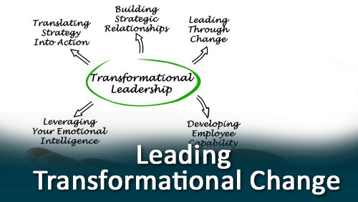
A MANAGEMENT INNOVATION: Toward Transformational Change
Notes:
To create the possibility of sustainability becoming a true, strategic priority, the organization’s relationship to its sustainability program must be redefined.
This means bringing leadership to rethink the defined function(s) of the program in place.
Success is likely to demand refocusing your sustainability program and the actions that are adopted through it.
Let’s look at an example: The Shift From Paper- to Electronically-Based Operating Practices
At some point leaders came to believe their organization’s success and/or livelihood rested on their ability to transform operations from being paper-based to electronically-driven.
The programs put in place to manage this change were seen as critical to the organization’s ongoing performance and expected to result in deep change.
This wasn’t always the case. Before it was commonly believed that integrating information technology was essential to success, an internal IT advocate would likely find it exceedingly difficult to implement foundational organization changes;
the same way a sustainability manager is largely constrained today.
As leaders, we can either wait for leadership to come on board when sustainability’s importance is more universally accepted, or we can attempt to innovate, orchestrate and take action in ways that effectively encourage openness and new ways of doing business.

Slide 11
A MANAGEMENT INNOVATION:
Self-Reflection Questions
What outcomes are important to leadership that your sustainability program could contribute to positively?
What function should your sustainability program ideally perform?
Notes:
These are some of the important questions that Ryerson’s sustainability team answered as part of speculating and strategizing around how our program could best drive overall organizational performance
Say what you think works.

Slide 12
WEBINAR AGENDA
Assessing What’s in Focus
A Management Innovation
Introduction to REFOCUS
The Stories of AASHE Members
Question & Answer Period

Slide 13

INTRODUCTION TO REFOCUS: Filling the Market Gap
???
=
Organizational Measurement & Reporting
Program Development & Management
Notes:
Currently, many of you use STARS as a comprehensive and disciplined way of measuring managing performance across indicators.
Based on our best experience globally, to elevate a sustainability program and affect deeper change
we need to be similarly disciplined and methodical in how we prioritize and take action to advance how a sustainability program is developed and managed
This can look like anything from
Enhancing and acquiring new organizational capabilities
Building our personal leadership competencies
More consistently maximizing value creation in alignment with organizational priorities
More effectively demonstrating impact generated and compellingly communicating the results
Analyzing, planning and evoking change systemically
As much as there are literally hundreds of sustainability solutions out there, based on all of our research, we haven’t found one that effectively maps out the entire scope of what a sustainability leader needs to manage
CLICK
It was in response to this gap that the REFOCUS educational program was created three years ago and successfully launched as a standalone non-profit co-operative in Jan of 2017

Slide 14
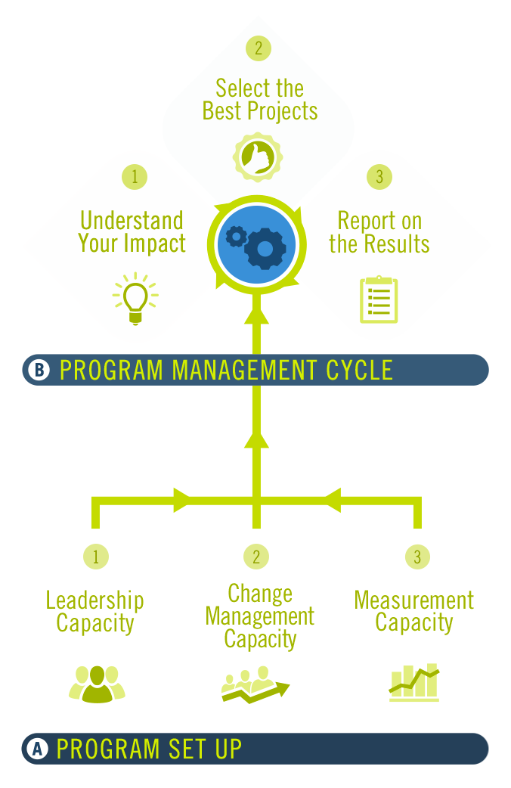
INTRODUCTION TO REFOCUS: Sustainability Program Model
Program Management Cycle:
Focused the adoption of sustainability projects.
Process for deciding how to use limited resources to adopt projects that offer greatest benefit.
Repeated and refined year-over-year
Program Setup:
Involves developing the program’s foundation.
Designed to build the critical capacities needed.
Demands a significant upfront effort.
Capacities are assessed and improved over time.
Notes:
REFOCUS was founded on the belief that how well a sustainability program is set up and managed is the strongest indicator of an org’s ability to progress over time.
REFOCUS covers disciplines related to both sustainability and organizational change and delivers the practical know-how needed to set up, implement and operate a transformational program.
REFOCUS helps practitioners to assess how well every aspect of their sustainability program has been developed and is operating, regardless of how sustainably their organization is currently functioning.
CLICK
Program Set Up
Participants are stepped through the process of building the capacities needed for a sustainability program to strengthen the bottom line.
These capacities are like the roots of a plant. While they are not visible on the surface, they are crucial to the program’s success.
Leadership, Change Management, and Measurement Capacity.
CLICK
Program Management Cycle:
Like a flower that blooms each year, defines a cycle of steps repeated annually to ensure limited resources go into projects that maximize benefits returned.
Understanding Your Impact, Selecting the Best Projects, and Reporting on the Results.
Process is usually where most organizations focus efforts but results of which are largely influenced by how soundly the program has been set up.
As we get to know the interactivity of the model, it becomes clear how lacking program capabilities, will significantly impact the value that’s generated
Most who are introduced as quite captured because for the first time they can simply, clearly and accurately grasp how all elements of a sustainability program fit together and interact
Like a management system, REFOCUS can be ongoingly applied to promote and measure progress toward an ideal state. This means REFOCUS:
Is valuable to orgs with a program at any stage of development/progress.
Its simplicity also makes it a valuable communication tool that can be leveraged to compellingly engage stakeholders with a focus on enabling the organization, rather than sustainability objectives.

Slide 15
INTRODUCTION TO REFOCUS: Educational Programming Model
Participants must first complete:
  A 1-2 day session that familiarizes participants with our methodology, the inspiring HFC story and concludes with a detailed program self-assessment.
1. The REFOCUS Professional Certification Workshop
Once certified, you can access :
  A REFOCUS-managed online platform that features interactive content and hundreds of useful resources profiled to support deeper learning and application.
2. The REFOCUS Guidebook & e-Library of Resources
You can also participate in:
  A yearlong, peer-based learning experience repeated annually to help participants evoke developing deeper change by applying REFOCUS.
3. The REFOCUS Applied Certification Program
Notes:
The REFOCUS educational program has three key elements
A 1-2 day session that familiarizes participants with our methodology, the inspiring HFC story and concludes with a program self-assessment.
A REFOCUS-managed online platform that features interactive content and hundreds of useful resources profiled to support deeper learning and application
A yearlong, peer-based learning process repeated annually to help participants evoke developing deeper change by applying REFOCUS in response to self-assessment.

Slide 16
WEBINAR AGENDA
Assessing What’s in Focus
A Management Innovation
Introduction to REFOCUS
The Stories of AASHE Members
Question & Answer Period

Slide 17
August Certification
Workshop Details
Dates: August 8th (afternoon only) & August 9th, 201.
Location: University of Illinois at Chicago
Registration Fee: $450 (AASHE members), $550 (AASHE non-members)
To ensure a good fit between the workshop and attendees, a short on-line application is required.
Applications will be accepted on a rolling basis. Review of applications will begin on June 17, 2019, and continue until space is filled; early application is recommended.
The workshop is limited to 30 participants. If the event fills-up, we may close the registration process sooner. Register today to secure your spot!

Slide 18
WEBINAR AGENDA
Assessing What’s in Focus
A Management Innovation
Introduction to REFOCUS
The Stories of AASHE Members
Question & Answer Period

Slide 19

QUESTION & ANSWER PERIOD

Slide 20
August Certification
Workshop Details
Dates: August 8th (afternoon only) & August 9th, 201.
Location: University of Illinois at Chicago
Registration Fee: $450 (AASHE members), $550 (AASHE non-members)
To ensure a good fit between the workshop and attendees, a short on-line application is required.
Applications will be accepted on a rolling basis. Review of applications will begin on June 17, 2019, and continue until space is filled; early application is recommended.
The workshop is limited to 30 participants. If the event fills-up, we may close the registration process sooner. Register today to secure your spot!

Slide 21

CONCLUSION
Randy Sa’d
Founder & Executive Director
REFOCUS
randy@refocussustainability.com
www.refocussustainability.com

